Slide 1
Mr. B’s GUIDE TO CRQ’s
How to Answer Constructed Response Questions Correctly!!!!!!

Slide 2
Constructed Response Questions:
Ask you to apply your knowledge and understanding in a short written answer.
On standardized tests, these short written answers are scored as 1,2, or 3 points.
A full 3 point response answers all 3 parts of the question, usually two, two-part questions.

Slide 3
Let’s look at some examples: (We will start out with simple examples.)
Question: What are two characteristics of mammals? Give two examples.
Two characteristics of mammals are they are warm-blooded (1 point) and give birth to their young(2 points). Two examples of mammals are humans and bears (3 points).

Slide 4
Writing Tips for Your Response:
Prewriting:
Read the entire prompt.
Identify and underline key words in the question, such as: explain, elaborate, illustrate.
Restate the prompt in your own words to be sure that you understand it.

Slide 5
Prewriting, continued.
Make a list of the items you are supposed to identify in your answer.
Make a list of reasons that will support your answer.

Slide 6
Writing:
Use the question to form your topic sentence. (Use the same terms in the question for the first sentence of your paragraph answer!)
Make sure you include all Three parts of the question in your answer. Remember, you get a point for each part you answer correctly!

Slide 7
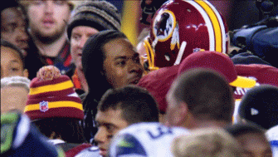
Writing, continued:
Make sure you EXPLAIN each item with a concrete detail—something specific!

Slide 8
Another example:
The sky is low
THE sky is low, the clouds are mean,
A travelling flake of snow
Across a barn or through a rut
Debates if it will go.
A narrow wind complains all day
How some one treated him;
Nature, like us, is sometimes caught
Without her diadem.
Emily Dickinson
Question: How does the word "person" give you a clue as to the meaning of personification? Why do you think a writer would want to use personification in a poem? List two examples of personification found in the poem at left.

Slide 9
Answer: The word “person” lets me know that personification means that some object in the poem has qualities or actions like a person.(1 point) A poet might use personification to help us feel a relationship to the object. (2 points) “The clouds are mean” and “narrow wind complains” (3 points) are both examples of personification.
Notes:
GHM

Slide 10
As you see, these are “short answer questions” and are not meant to be answered as an essay.
Identify the 3 parts of the question asked, then make sure that your response answers each of the 3 parts.
No answer at all gets 0 points!
Answering 1 part of the question correctly counts as 1 point, 2 parts = 2 points, and so on.

Slide 11
Now you try one alone:
Name your two favorite teachers and give a reason why each one is your favorite.

Slide 12
Share your answer with a partner near you.
Check your partner’s answer.
Does the answer begin with restating the question?
Has your partner answered all 3 parts of the question?
Score the answer 0, 1, 2, 3, according to completeness.

Slide 13
Is the answer explained with specific details?
Give your partner feedback about their response.
Tell your partner how they could have scored more points or explained their answer better.

Slide 14
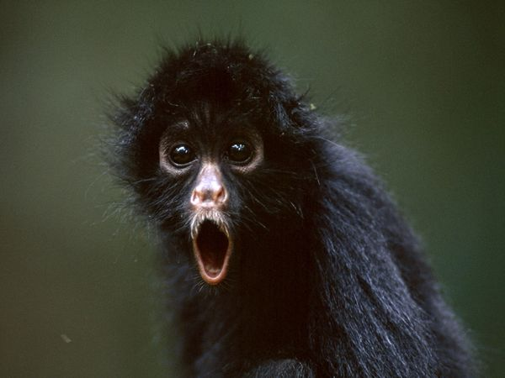
Bullets and Diagrams

Slide 15
Constructed Response Sample from WCPSS
Data Team- Spring 2013
Ideally–
“memorization and recitation of [the Qur’an]in its original language is necessary for the performance of the daily rituals….in the case of the Qur'an, although it has been translated into many languages, these translations cannot replace the original language as a language of worship, which continues to be Arabic for all Muslims, native speakers and others…Other holy books also came to be associated with specific languages, such as the Torah with Hebrew, and, perhaps less intimately, the New Testament with Greek and Latin. However, the nature of the relationship between the Qur'an and Arabic is still unique.”
Using the excerpt above, identify the holy book of the Islamic faith, the language in which it was originally written, and a lasting impact of this relationship.

Slide 16
Reading the Question
Data Team- Spring 2013
Using the excerpt above, identify the holy book of the Islamic faith, the language in which it was originally written, and a lasting impact of this relationship. (6.C.1.2)

Slide 17
Scoring the Response
Data Team- Spring 2013
The Quran is the holy book of Islam. It has traditionally been written in Arabic. This has resulted in Arabic being a recognized and spoken religion throughout the world.
1 point
1 point
1 point
3 total points

Slide 18
Scoring the Response - or this
Data Team- Spring 2013
Book = Quran
Language = Arabic
Effect = language spoken around the world
1 point
1 point
1 point
3 total points

Slide 19
Scoring the Response - Even this!
Data Team- Spring 2013
1 point
1 point
1 point
3 total points
The Quran is the Holy book of Islam
The Quran was written in Arabic
Arabic is spoken across the globe

Slide 20
• Identify three important Rulers or Leaders of Civilization and describe their contribution to their people. (for example, Montezuma, Mansa Musa).
Try one on your own

